Slide 1
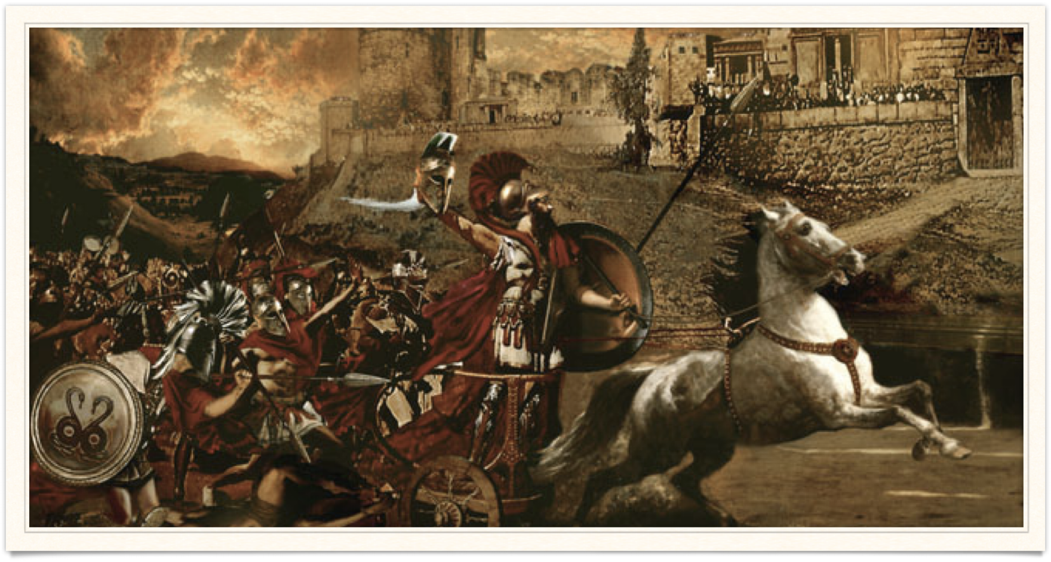
Troy/The Trojan War
Goal/s:
Identify the events/people/ideas of the trojan war
Locate troy on a map
Week 5 Lesson 2
Ms Barrie

Slide 2

In the 12th century BCE, the powerful Mycenaean civilization collapsed and Greece entered a dark age. During the next few centuries, stories of heroic Mycenaeans were handed down in the form of poems. Two of the most famous poems were written by the poet Homer in the eight century BCE: The Iliad describes how the city of Troy was besieged by the army of King Agamemnon of Mycenae, and The Odyssey describes the adventures of the Greek Hero Odysseus on his return from the Trojan War. It is likely that the Greeks and Trojans did go to war but over the ownership of land and crops, rather than the recapture of Helen.

Slide 3
For centuries, the mythological stories of the Trojan War have fascinated people around the world. The main written source of these traditional stories is Homer’s famous epic poem, the Iliad.
The name ‘Iliad’ comes from Ilion, another name for Troy.
The word ‘epic’ comes from the Greek word epos meaning ‘the spoken word. It is believed that the Iliad was written by the poet Homer.
There are many stories that make up the cycle of the stories called The Trojan War.
___________________________________________
Bronze Age conflict between the kingdoms of Troy and Mycenaean Greece
Made up of many stories and key characters
Significant role of Gods in influencing story

Slide 4
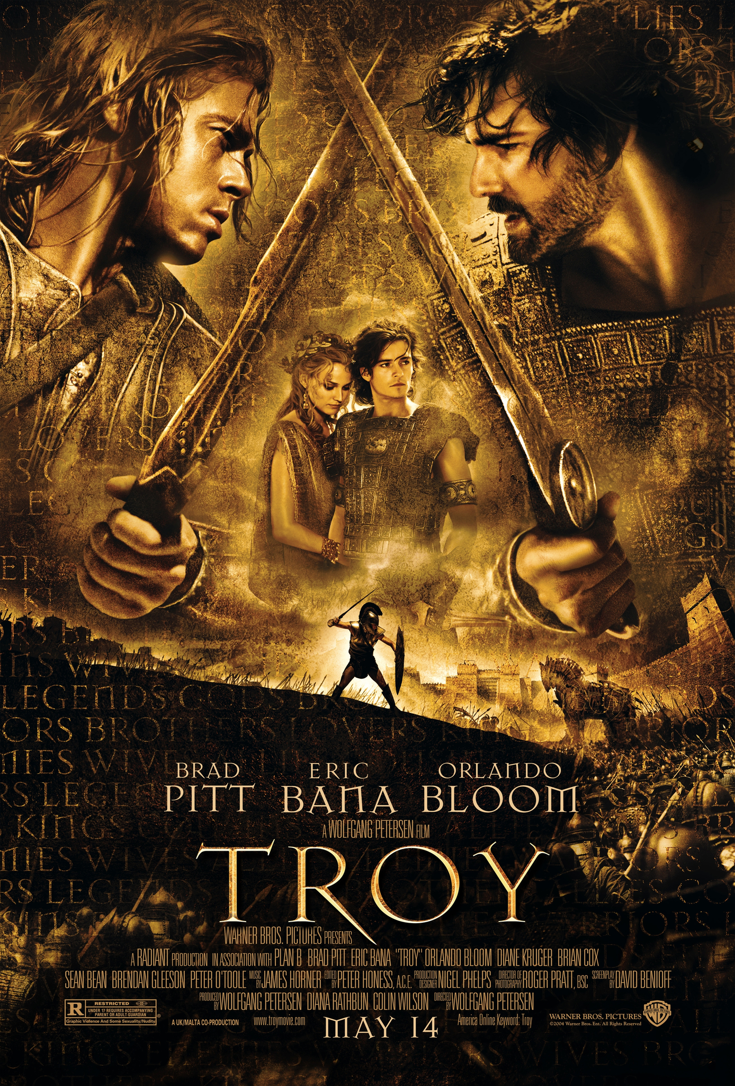
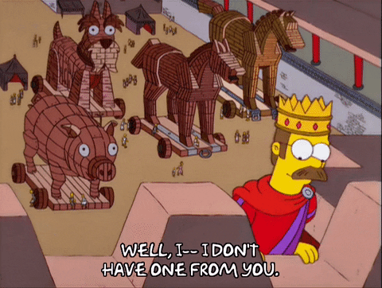
Troy/The Trojan War – Popular Media

Slide 5
Watch the following video:
https://www.youtube.com/watch?v=TOAraslCkgU&ab_channel=HISTORY

Slide 6
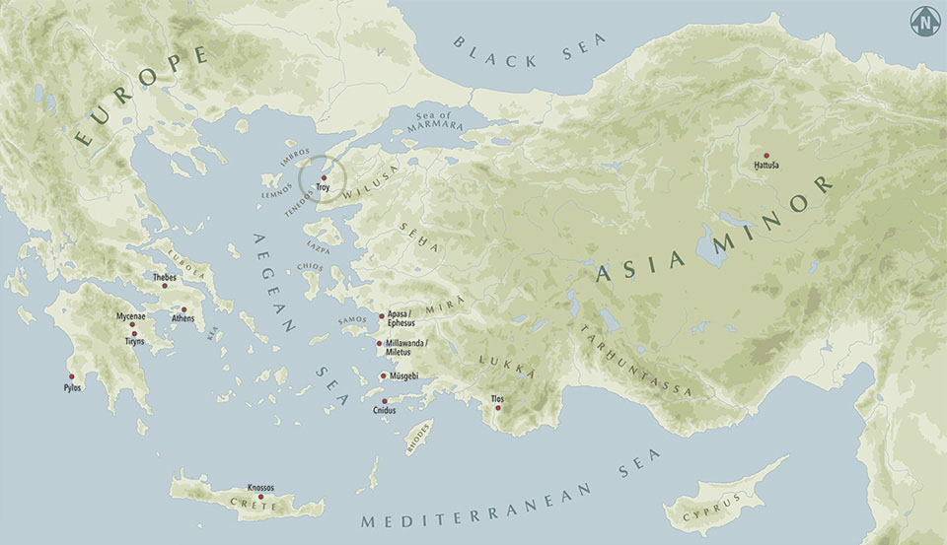

Slide 7
So what actually happened?
The Trojan War, in Greek Mythology, was a conflict between the city of Troy by the Achaeans (Greeks) and Mycenaean Greece after Paris of Troy took Helen from her husband, Menelaus, king of Sparta. The war is one of the most significant events in Greek mythology and was the source of many works of Greek literature, most notably Homer’s Iliad and the Odyssey.

Slide 8
Activity 1 – The story of the Trojan War
Read through the information sheet, as a class, about the Trojan War.

Slide 9
ACTIVITY 2 – Story Chart
Fill in the story chart about the myth of the Trojan War.

Slide 10
Extra time
https://www.youtube.com/watch?v=v2pCwxCX2as&ab_channel=TheBritishMuseum

